Slide 1
Secure data hiding in images using steganography
CAPSTONE PROJECT
Presented By:
Student Name : Aniket Dohale
College Name : Sardar Patel Institute of Technology
Department : Computer Engineering

Slide 2
OUTLINE
Problem Statement
Technology used
Wow factor
End users
Result
Conclusion
Git-hub Link
Future scope

Slide 3
Problem statement
In the modern age of the digital world, privacy and data protection are extremely important.
Conventional encryption techniques tend to invite suspicion and unwanted attention, so the need arises to design subtle means of secure communication.
The problem is to conceal confidential information within digital images in a way that is not perceivable to the human eye and ensures that the quality of the image and the encrypted data are maintained.

Slide 4
Technologies used
Programming Language: Python
Libraries: OpenCV, PIL, Tkinter
Algorithm: Least Significant Bit (LSB) Steganography
IDEs: Visual Studio Code, Notepad++
Operating System: Windows 11

Slide 5
Wow factors
Invisible Data Embedding: Sensitive information is hidden within images without altering the visible appearance.
Password Protection: Ensures that only authorized users can extract the hidden message.
User-Friendly GUI: Allows even non-technical users to encrypt and decrypt messages with ease.
Cross-Platform Compatibility: The tool can run on Windows, Linux, and MacOS.

Slide 6
End users
Business Organizations: To protect confidential company information.
Government and Military: For safe transfer of classified information.
General Public: For personal data privacy and protection.
Journalists and Activists: For private communication in critical scenarios.

Slide 7
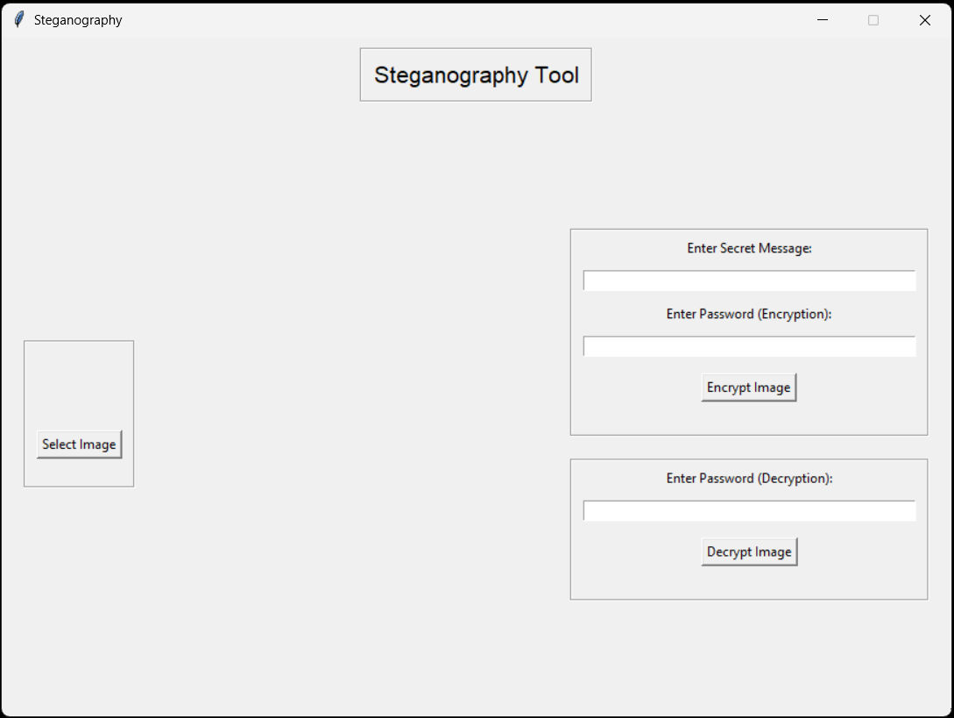
Results

Slide 8
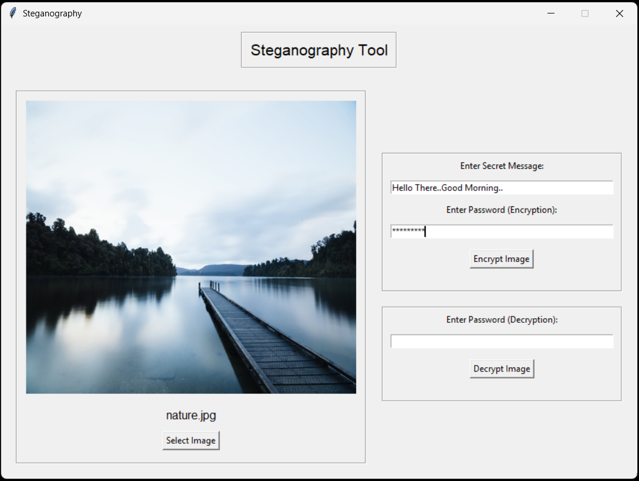
Results

Slide 9
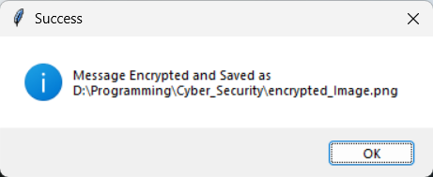
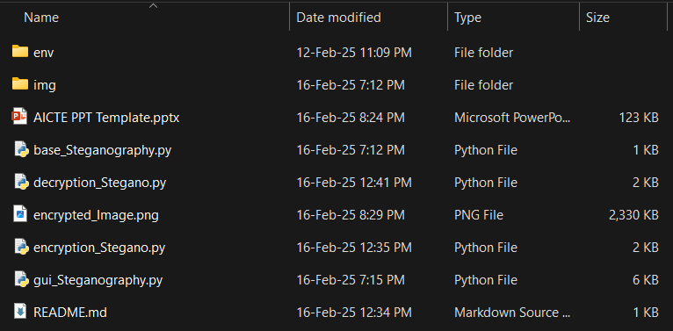
Results

Slide 10
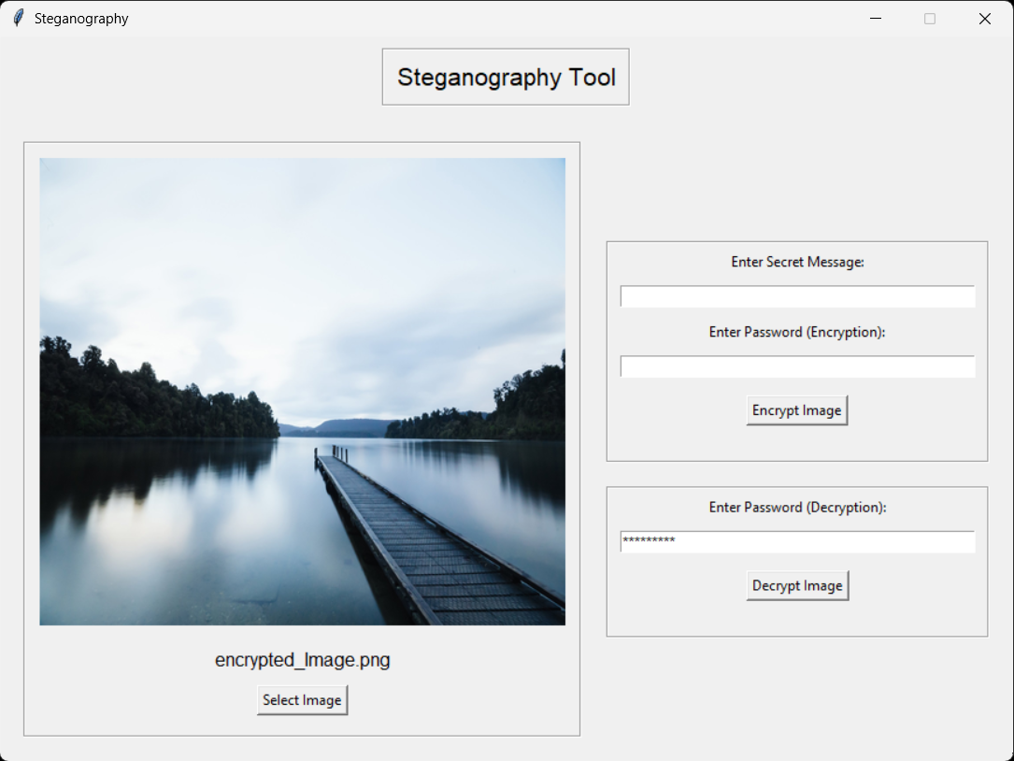
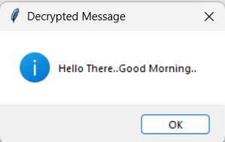
Results

Slide 11
conclusion
Steganography offers a powerful solution for secure data hiding, ensuring privacy without raising suspicion.
By embedding sensitive messages within digital images, this tool provides a covert and effective means of communication.
The combination of a user-friendly interface and robust encryption ensures that the data remains safe and accessible only to intended recipients.

Slide 12
GitHub link
https://github.com/AniketDohale/Steganography.git

Slide 13
Future scope
Advanced Encryption Methods: Using stronger cryptographic techniques for improved security.
Support for Various Media Formats: Expanding to include audio and video steganography.
Cloud Integration: Enabling secure storage and access of encrypted images online.
Real-Time Solutions: Creating mobile apps for secure communication anytime, anywhere.

Slide 14
THANK YOU

